Slide 1


Slide 2


Slide 3

SOUTH AFRICAN ECONOMY
Exchange Rate
Fuel Price VS Sales
Inflation Rate
Interest Rate
Notes:
The fuel price has increased 52% from Jan 2020 to Nov 23

Slide 4
SOUTH AFRICAN ECONOMY
Employment Rates
The current population of South Africa is 62 027 502 (Females makes up 31 948 745) as per 2022 Census. The latest unemployment rate for Q3 shows 31,9%.

Slide 5
MEMBERSHIP STATISTICS
+1 Title
243
237
- 7 Titles
169
166
- 3 Titles
30 Jun 23: 412
30 September 23: 403
ABC Members:

Slide 6
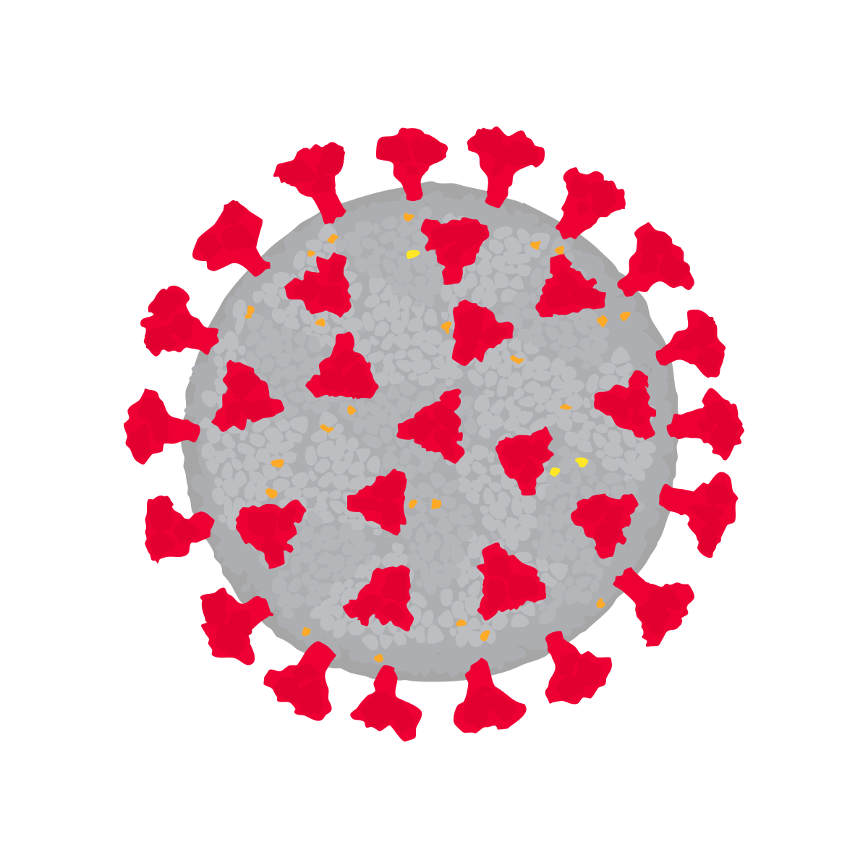
NEWSPAPER OVERVIEW
7 559 280 | 1 750 348 | 5 253 671 | 5 784 741 | 6 072 987 | 5 828 320 | 5 812 294 | 6 704 689 | 6 678 425 | 6 624 795 | 6 510 853 | 6 602 226 | 6 591 314 | 6 385 557 | 6 315 145
20% 20% 26% 25% 6% 6% 0% 0% 42% 43% 6% 7%

Slide 7
DAILY NEWSPAPER OVERVIEW
579 299 | - | 249 999 | 344 284 | 351 465 | 344 284 | 323 702 | 320 413 | 312 544 | 301 557 | 291 847 | 278 637 | 269 644 | 254 702 | 225 653
46,20% 41,57% 20,65% 22,45% 2,54% 2,66% 6,23% 6,37% 12,93% 13,84% 11,46% 13,11%

Slide 8
WEEKEND NEWSPAPER OVERVIEW
823 162 |  | 406 841 | 504 496 | 514 248 | 504 496 | 484 407 | 467 261 | 456 377 | 437 593 | 427 807 | 414 331 | 392 038 | 363 904 | 353 329
47,04% 46,83% 26,92% 26,57% 1,49% 1,20% 2,63% 3,17% 8,43% 8,28% 13,48% 13,94%

Slide 9
WEEKLY NEWSPAPER OVERVIEW
309 568 | 5 611 | 157 076 | 182 236 | 184 391 | 182 236 | 181 843 | 165 812 | 163 793 | 154 975 | 156 879 | 142 112 | 137 298 | 134 495 | 149 662
79,13% 85,86% 6,25% 5,58% 6,10% 0,17% 3,05% 2,36% 0,99% 1,08% 4,48% 4,95%

Slide 10
FREE NEWSPAPER OVERVIEW
5 593 840 | 1 659 002 | 4 256 471 | 4 573 224 | 4 804 969 | 4 381 646 | 4 618 015 | 5 556 245 | 5 552 254 | 5 529 036 | 5 437 775 | 5 570 693 | 5 631 570 | 5 434 637 | 5 390 665
75,33% 76,55% 24,49% 23,26% 0,18% 0,19%

Slide 11
LOCAL NEWSPAPER OVERVIEW
230 393 | 28 828 | 122 019 | 126 321 | 128 391 | 126 321 | 126 608 | 122 329 | 127 863 | 122 487 | 117 066 | 113 576 | 112 856 | 107 886 | 105 643
64,71% 64,33% 0,49% 1,15% 29,96% 31,06% 0,62% 0,63% 1,19% 0,40% 3,02% 2,42%

Slide 12
MAGAZINE OVERVIEW
7 652 020 | 4 532 653 | 4 625 107 | 4 382 475 | 3 629 947 | 4 029 239 | 4 250 078 | 3 812 924 | 3 370 804 | 3 515 947 | 3 247 745 | 3 553 670 | 3 233 338 | 3 002 243 | 2 947 310
20% 20% 26% 25% 6% 6% 0% 0% 42% 43% 6% 7%

Slide 13
CONSUMER MAGAZINES
2 976 057 | 1 875 685 | 1 897 393 | 1 426 139 | 1 129 365 | 1 125 649 | 1 233 666 | 1 177 085 | 1 108 352 | 1 091 035 | 1 023 944 | 974 500 | 954 455 | 899 992 | 911 504
55% 51% 5% 4% 18% 18% 19% 23% 4% 4%

Slide 14
BUSINESS TO BUSINESS MAGAZINES
944 705 | 772 215 | 820 828 | 953 208 | 802 496 | 808 135 | 955 204 | 837 740 | 676 804 | 543 256 | 537 417 | 608 309 | 519 338 | 533 840 | 522 906
1,32% 0,88% 1,44% 1,96% 1,58% 1,21% 95,38% 95,73% 0,28% 0,22%

Slide 15
CUSTOM MAGAZINES
3 553 010 | 1 814 558 | 1 804 893 | 1 912 467 | 1 606 509 | 2 000 320 | 2 164 381 | 1 703 837 | 1 366 952 | 1 495 250 | 1 262 183 | 1 494 116 | 1 308 248 | 1 077 979 | 1 066 079
2,84% 2,81% 64,69% 65,13% 0,72% 0,73% 17,96% 17,17% 14,19% 14,56%

Slide 16

Newspapers down -1%
Magazines down -2%
Daily newspapers under pressure while Free is stable
News Single copy -5% News Subs up by 2%
Mags -1% on SC while Subs is flat
ABC Membership 403 from 412
New rules to support change in the model
Digital Publications an ABC focus

Slide 17


